Slide 1



Noida Institute of Engineering and Technology, Greater Noida
Semi-Conductor Physics and
Information Storage
Unit: 4
Engg. Physics
Dr. Rajesh Kumar
B.Tech (1st Sem.)

Slide 2
Content
Introduction to the Concept of electrical conductivity
Conductivity of conductors and semiconductors
Fermi- Dirac distribution function
Position of Fermi level in intrinsic and in extrinsic semiconductors
Variation of Fermi level with temperature
Photovoltic effect
Solar cell
Basics of magnetic, and semiconductor memories

Slide 3
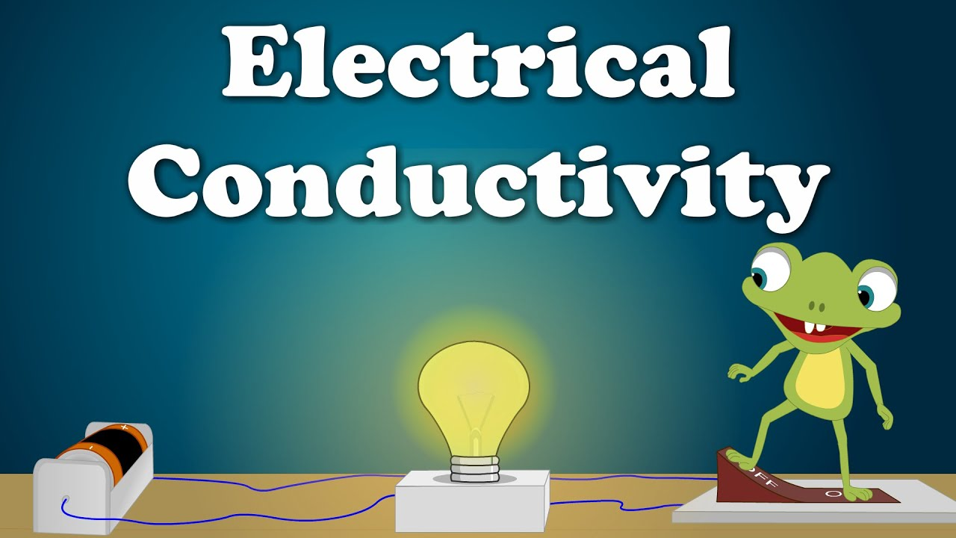
Conductivity is the phenomenon of transmitting something like heat, electricity or sound.
Electrical conductivity is a result of the movement of electrically charged particles inside the material.

Slide 4
Electrical conductivity
Most important properties of metals are high thermal and electrical conductivity.
Electrical conductivity is that property which measures the ability of material to allow the electric current to flow
Silver has highest electrical conductivity
Ideal metal has higher conductivity
Insulators has lower conductivity
Metals having complex structure such as As, Sb, Bi, Sn , Hg have lower conductivity compare to ideal metals and large conductivity compare to insulators

Slide 5
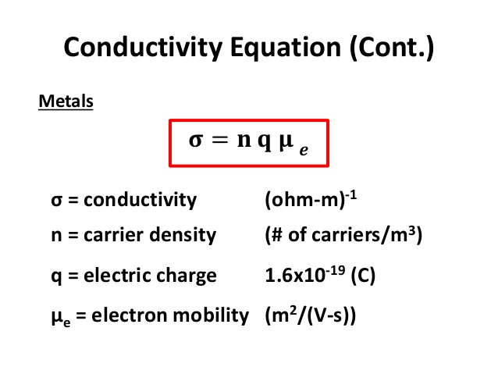
Electrical conductivity formulae
Atoms of metal elements are characterised by the presence of valence electrons. Electrons in the outer shell which are free to move . These free electrons are allow metals to conduct an electric field.
Conductivity equation in the case of metals is given as

Slide 7
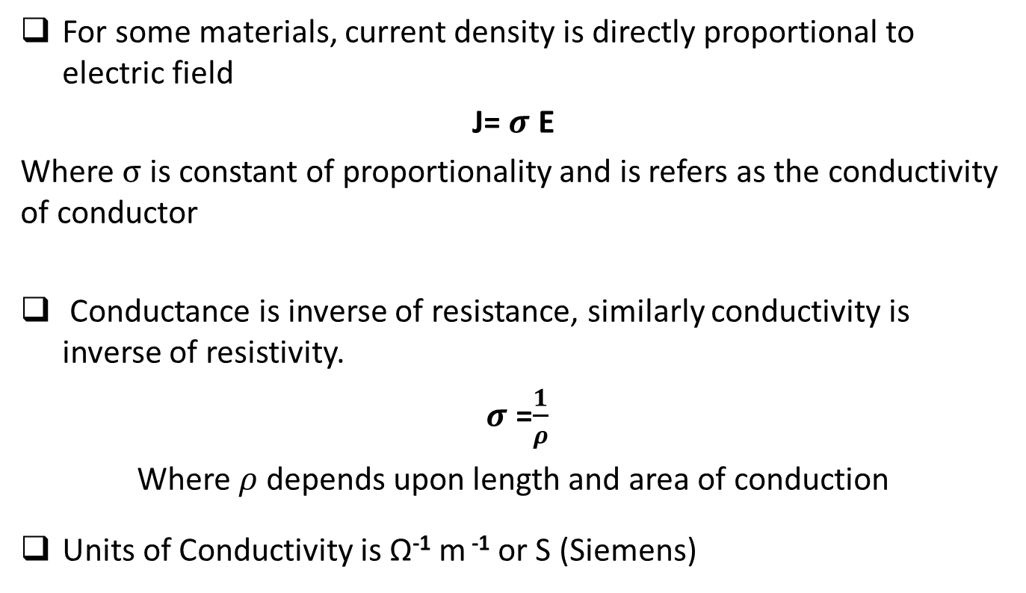
Electrical conductivity formulae
For some materials, current density is directly proportional to electric field
J= $σ$ E
Where $σ$ is constant of proportionality and is refers as the conductivity of conductor
Conductance is inverse of resistance, similarly conductivity is inverse of resistivity.
$σ$ =$\frac{1}{ρ}$
Where $ρ$ depends upon length and area of conduction
Units of Conductivity is Ω⁻¹ m ⁻¹ or S (Siemens)

Slide 8
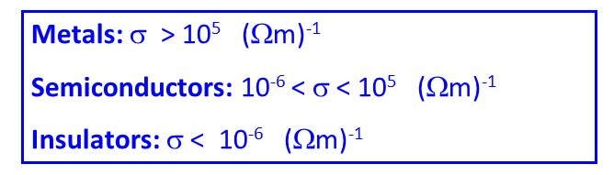
Conductivity of Conductors and semiconductors
Conductors: Mostly are metals (that allow current to flow)
higher electrical conductivity
Insulators : Non-metals (don’t allow current to flow)
lower electrical conductivity
Semiconductor : Metalloids
Electrical conductivity lies between above two

Slide 9
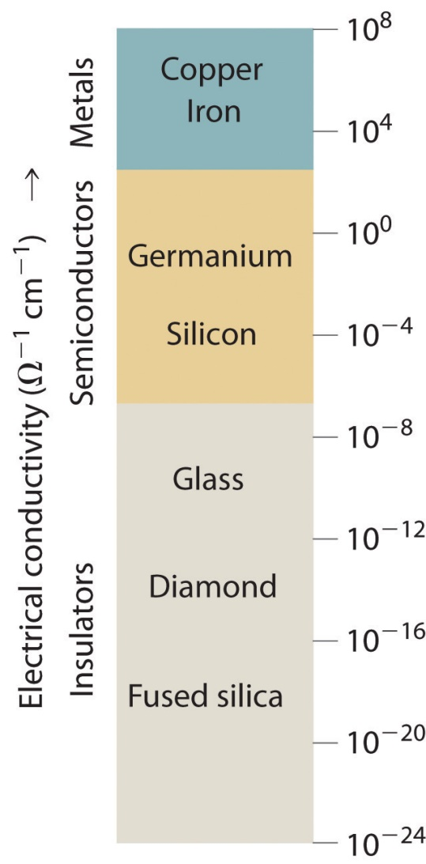
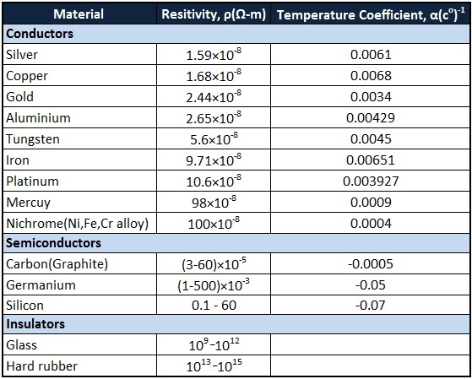
Few examples

Slide 10
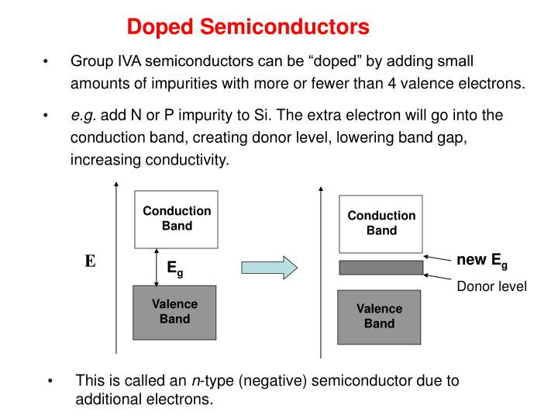
Classification of solids on the basis of band theory
There are three bands in solids
Valence band: Band of energy occupied by valence/outer electrons is known as valence band. It is either complete or partially filled.
Conduction band: It is the permitted energy band which has higher energy. It may be unfilled or partially filled.
Forbidden energy gap/band: In between these two bands, there is a gap that is refers as forbidden gap. Electrons cannot exist in this gap.

Slide 11
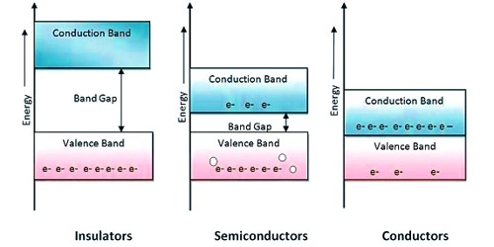
Classification of solids on the basis of band theory
Insulator – large band gap b/w valence and conduction band
Conductor – overlapping bands
Semiconductor- forbidden gap lies near about 1ev

Slide 12
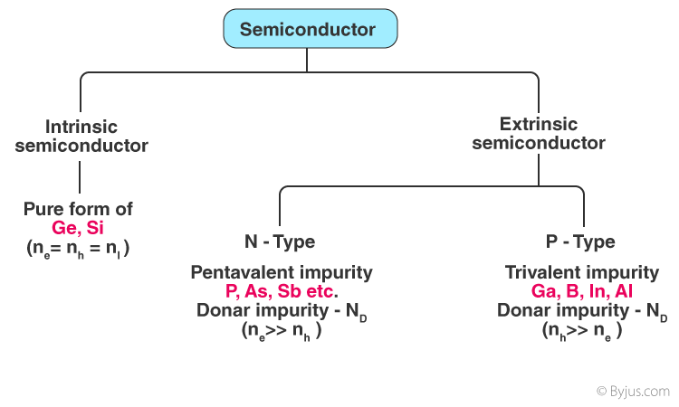
Types of Semi-Conductor

Slide 13
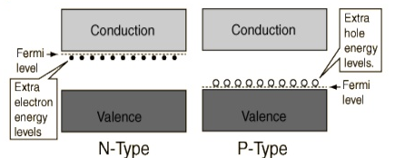
Band theory on Extrinsic semi-conductor
N-Type – For each impurity atoms one energy state (donar state) is introduced in the band gap just below the conduction band
P-Type – For each impurity atoms one energy state (acceptor state) is introduced in the band gap just above the valence band

Slide 14
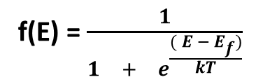
Fermi-Dirac Distribution function
Fermi Level:
Fermi level(E_{f}) is defined as the highest filled energy level in conductor at 0 K.
Fermi-Dirac Probability distribution function controls the distribution of electrons among the energy levels as a function of temperature.
Fermi –Dirac probability distribution function is
Where E_{f} =Fermi-Energy
k=Boltzmann’s constant
T= temp.
f(E) = $\frac{1}{\begin{matrix}1 & + & e^{\frac{( E − E_{f})}{kT}}\end{matrix}}$

Slide 15
The function f(E)=1, when an energy is filled by electrons
The function f(E)=0, for an empty energy level.

Slide 16
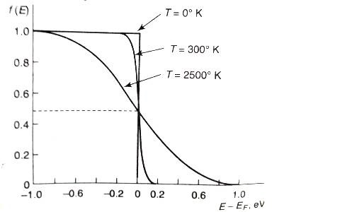
Fermi-Dirac Distribution function at temp 0K
When T=0K and E> E_{f} then F(E) =0
When T=0K and E< E_{f} then F(E) =1
When T=0K and E= E_{f} then F(E) = 1/2
Means 0< f(E) <1

Slide 17
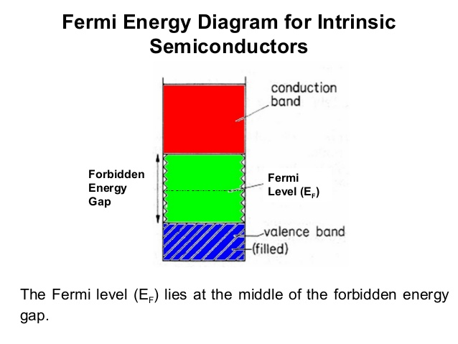
Fermi Energy & Fermi Level
It is the energy level above which probability for finding electrons is zero at absolute 0K in the case of semiconductor.
No electrons exist above fermi energy level at 0K

Slide 18
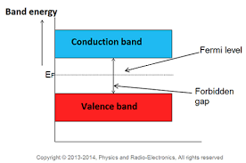
Position of Fermi-level in Intrinsic Semiconductor
No. of electron and holes are equal in the case of intrinsic semi-conductor. Thus fermi level lies exactly between conduction and valence band.
At absolute 0K, all energy state above fermi level are empty and below of it are occupied

Slide 19
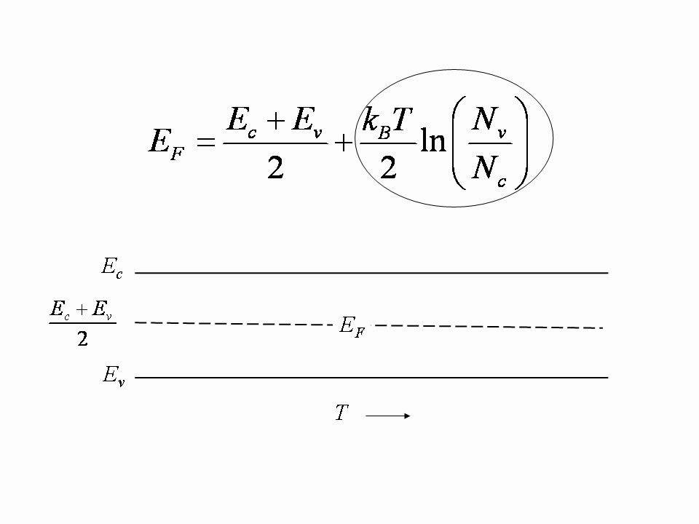
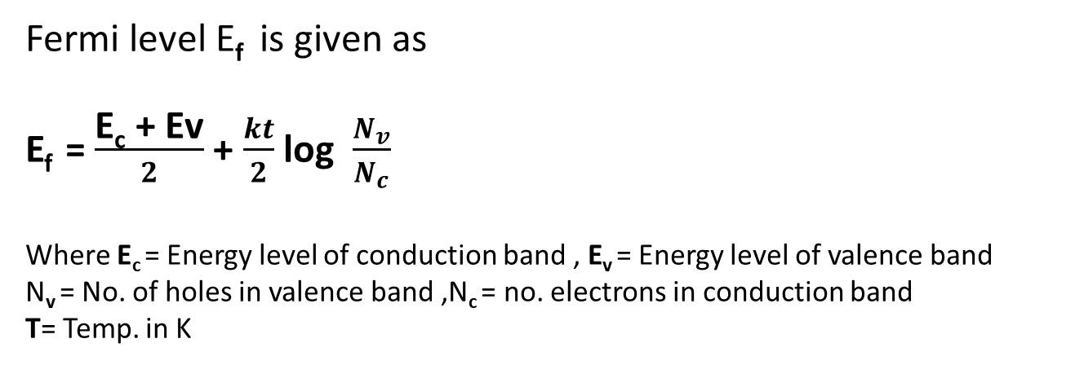
Fermi-level in Intrinsic Semiconductor
Fermi level E_{f} is given as
E_{f} = $\frac{\text{E}\text{c}\text{ + }\text{Ev}}{2}$ + $\frac{kt}{2}$ log $\frac{N_{v}}{N_{c}}$
Where E_{c} = Energy level of conduction band , E_{v} = Energy level of valence band
N_{v} = No. of holes in valence band ,N_{c} = no. electrons in conduction band
T= Temp. in K

Slide 20
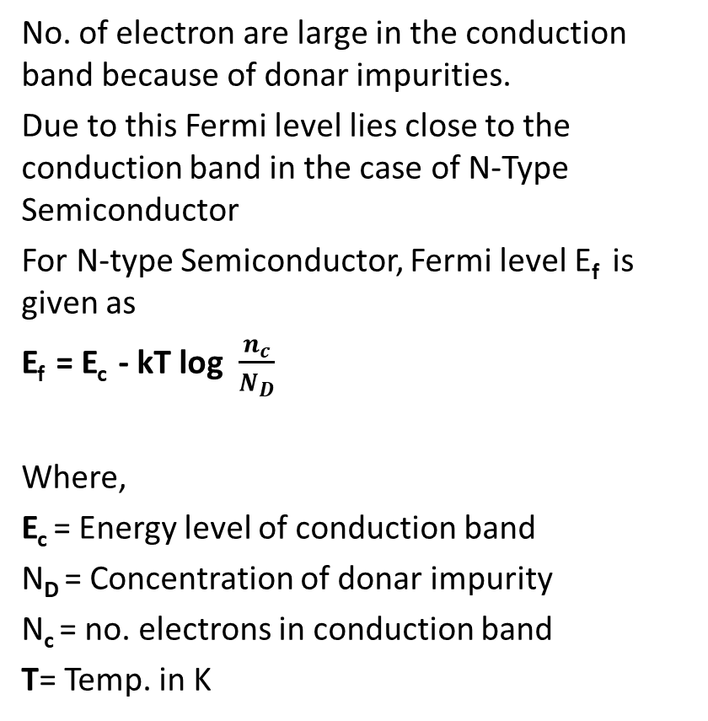
Position of Fermi-level in N-Type Semiconductor
No. of electron are large in the conduction band because of donar impurities.
Due to this Fermi level lies close to the conduction band in the case of N-Type Semiconductor
For N-type Semiconductor, Fermi level E_{f} is given as
E_{f} = E_{c} - kT log $\frac{n_{c}}{N_{D}}$
Where,
E_{c} = Energy level of conduction band
N_{D} = Concentration of donar impurity
N_{c} = no. electrons in conduction band
T= Temp. in K

Slide 21
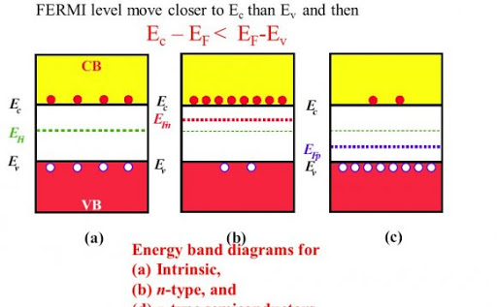
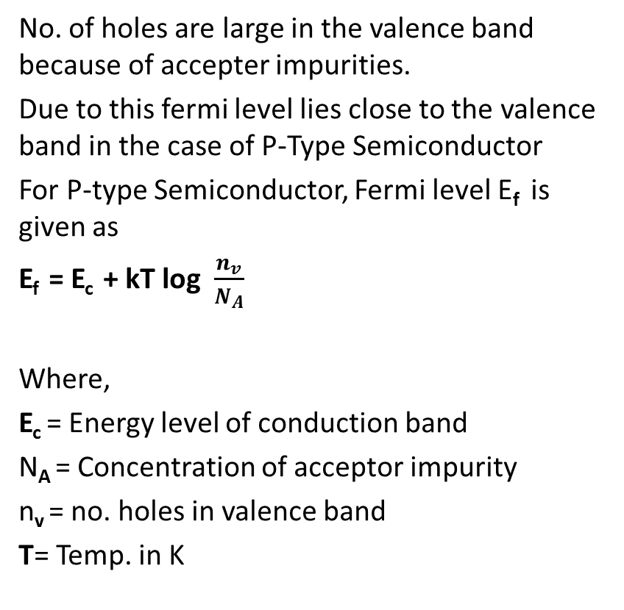
Position of Fermi-level in P-Type Semiconductor
No. of holes are large in the valence band because of accepter impurities.
Due to this fermi level lies close to the valence band in the case of P-Type Semiconductor
For P-type Semiconductor, Fermi level E_{f} is given as
E_{f} = E_{c} + kT log $\frac{n_{v}}{N_{A}}$
Where,
E_{c} = Energy level of conduction band
N_{A} = Concentration of acceptor impurity
n_{v} = no. holes in valence band
T= Temp. in K

Slide 22
Weekly Assignment
Q.1) What do you mean by Fermi level and derive Fermi level in
intrinsic semiconductor?
Q.2) Explain the variation of Fermi level with temperature in extrinsic
semiconductor.
Q.3) Show that at 0K fermi level lies exactly mid of the valence and
conduction band

Slide 23
Noida Institute of Engineering and Technology, Greater Noida
Semi-Conductor Physics and
Information Storage
Unit: 4
Engg. Physics
Dr. Rajesh Kumar
B.Tech (1st Sem.)

Slide 24
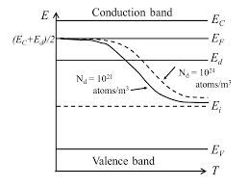
Position of Fermi-level in N-Type semi-conductor with temperature
Increase in temp. generate electron hole pair due to the breaking of covalent bond. Thus material tends to behave more like intrinsic semi-conductor.
E_{f} tends to move downwards as no. of holes increases with increase in temp.
E_{f} is the fermi level of intrinsic semiconductor

Slide 25
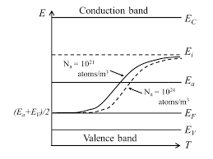
Position of Fermi-level in P-Type semi-conductor with temperature
Increase in temp. generate electron hole pair due to the breaking of covalent bond. Thus material tends to behave more like intrinsic semi-conductor.
E_{f} tends to move upwards as no. of electrons increases with increase in temp.
E_{f} is the fermi level of intrinsic semiconductor

Slide 26
MCQ
Energy band is high
(a) insulator (b) conductor
( c) both (a) and (b) (d) semi-conductor
2. Fermi level in case of intrinsic semi-conductor lies
(a) above of donar level (b) none of these
(c) below of donar level (d) exact mid of valence and
conduction band
3. Fermi level in case of P-type semiconductor lies
(a) above of donar level (b) above of Acceptor level
(c) below of donar level (d) below of Acceptor level

Slide 27
MCQ
4. Fermi level in case of P-type semiconductor lies
(a) above of donar level (b) above of Acceptor level
(c) below of donar level (d) below of Acceptor level

Slide 28
Weekly Assignment
Q.1) Comment on variation of E_{f} with doping concentration and
temperature.
Q.2) Distinguish between N-type and P-Type semiconductor

Slide 29
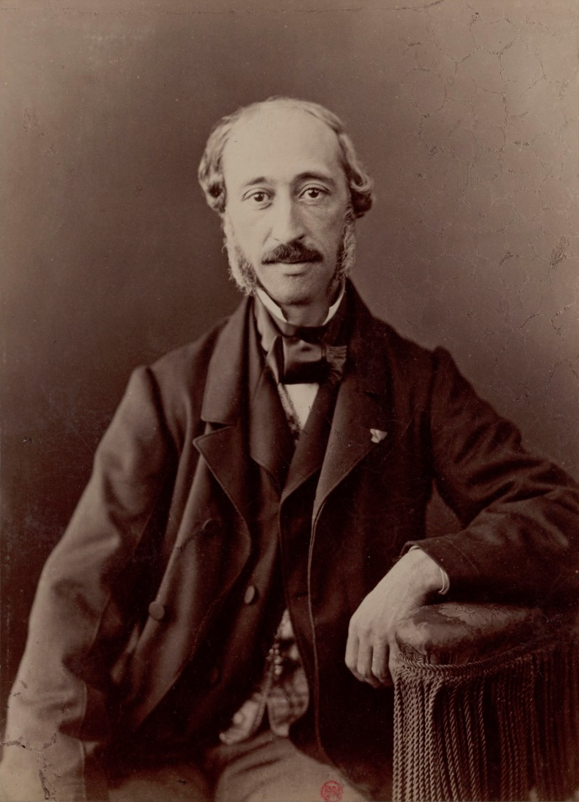
Photo-voltaic effect
Photo-voltaic effect was first discovered in 1839 by Edmond Becquerel.
Creation of a voltage in a material upon exposure to EM radiation is known as photo-voltaic effect
Certain semiconductor materials absorb certain wavelength.
E.g: crystalline silicon

Slide 30
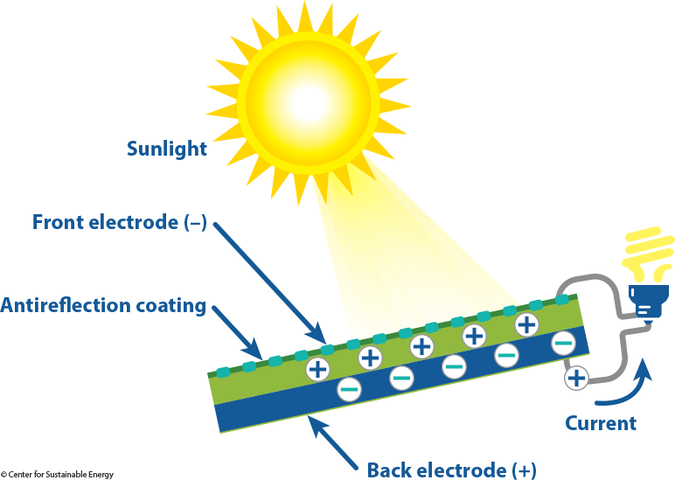
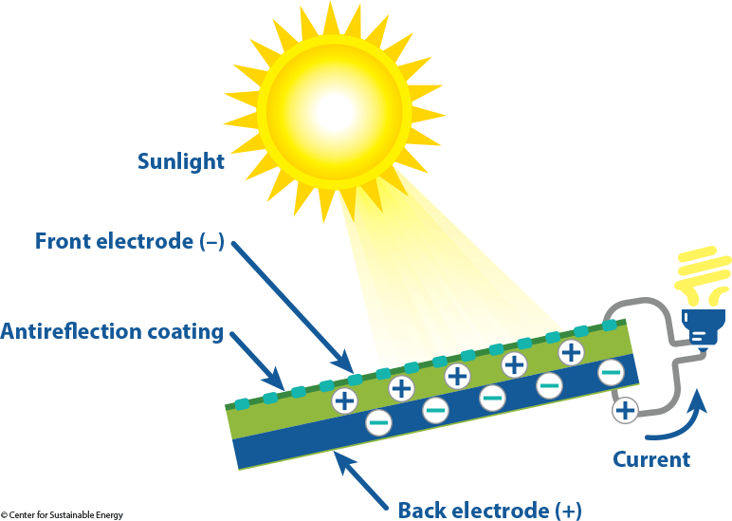
Photo-voltatic effect

Slide 31
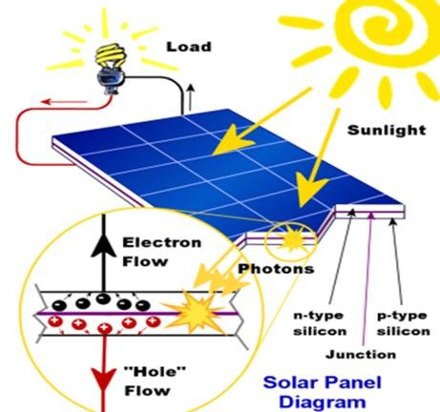
Solar Cell
A solar cell (also known as a photovoltaic cell) is defined as an electrical device that converts light energy into electrical energy through the photovoltaic effect.

Slide 32
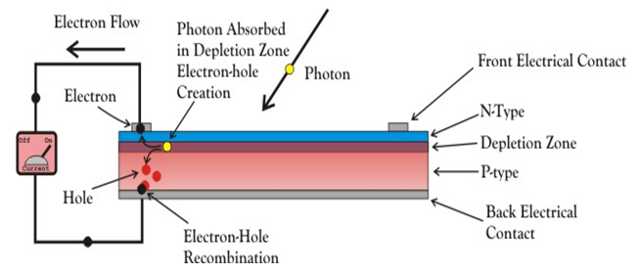
Construction of Solar Cell

Slide 33
Working of Solar Cell
When light falls on the p-n junction, it can easily enter in the junction to create a number of electron-hole pairs. The free electrons in the depletion region can quickly come to the n-type side of the junction. Similarly, the holes in the depletion can quickly come to the p-type side of the junction.
Once, the newly created free electrons come to the n-type side, it cannot further cross the junction because of barrier potential of the junction. Similarly holes which come to p-type side can’t cross the junction.
As the concentration of electrons becomes higher in one side, i.e. n-type side of the junction and concentration of holes becomes more in another side, i.e. the p-type side of the junction, the p-n junction will behave like a small battery cell.
A voltage is set up which is known as photo voltage. If we connect a small load across the junction, there will be a tiny current flowing through it.

Slide 34
Advantage and disadvantages of Solar Cell
Advantages:
No pollution associated with it.
It must last for a long time.
No maintenance cost.
Disadvantages:
It has high cost of installation.
It has low efficiency.
During cloudy day, the energy cannot be produced and also at night we will not get solar energy.

Slide 35
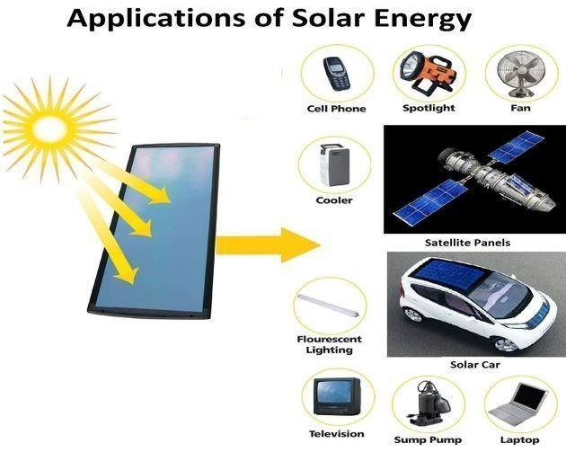
Applications of Solar Cell

Slide 36
Weekly Assignment
Q.1) Explain photovoltaic effect
Q.2) Explain the construction and working of Solar cell.

Slide 37
Memories
Memory is the device that is used to store data on a temporary or permanent basis for use in a electronic digital computer.
3 different categories of computer memory
Main memory (Primary memory) : That stores small amount of data and information that will be immediately used by the CPU
Secondary memory (Back up): That stores much large amount of data and information (an entire software program) for external periods of time
Internal Processor memory: That stores temporary storage of instruction and data.

Slide 38
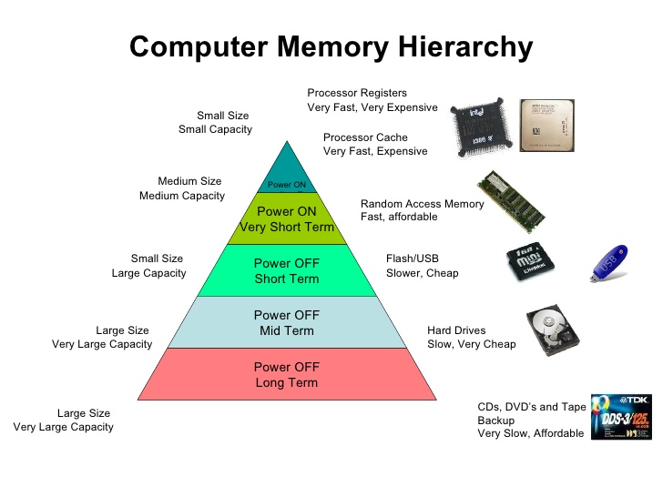
Computer Memory hierarchy

Slide 39
Types of Main Memory
Semiconductor Memory :
Semiconductor memories uses semiconductor-based integrated circuits to store information. Both volatile and non-volatile forms of semiconductor memory exist.
RAM and ROM are Semiconductor memory
Magnetic Memory:
Magnetic memory uses different patterns of magnetization on a magnetically coated surface to store information. Magnetic storage is non-volatile.
Magnetic tape and floppy are magnetic memory

Slide 40
You-tube Video Links
https://www.youtube.com/watch?v=64nr4hDtVTg
https://www.youtube.com/watch?v=0u3MTNeOtg0
https://www.youtube.com/watch?v=1DHCV3LgITY&t=408s
https://www.youtube.com/watch?v=kCN-7wA8HUE
https://www.youtube.com/watch?v=lc8R-wqEnk0
https://www.youtube.com/watch?v=Afwx9bxvT3s
https://www.youtube.com/watch?v=zh5HS1sUYhw
https://www.youtube.com/watch?v=7m17eYAtNZo
https://www.youtube.com/watch?v=sXcsKzJylrA
https://www.youtube.com/watch?v=V0yzDRDU_BU

Slide 41
NPTEL video Links
https://nptel.ac.in/courses/108108122/
https://nptel.ac.in/courses/115104109/

Slide 42
Daily Quiz
Q.1 Give the Band theory of soilds.
Q.2 Define Fermi-Dirac distribution function.
Q.3 Define Fermi energy level.
Q.4 Define conductivity of a semiconductor.

Slide 43
MCQ
1. Solar cell function is based upon
(a) photoelectric effect (b) None of these
(c) Photovoltaic effect (d) photosynthesis effect
2. RAM stands for
(a) Random access memory (b) None of these
(c) Read access memory (d) Read only memory
3. Semiconductor memory are
(a) RAM (b) ROM
(c) both (a) and (b) (d) None of these

Slide 44
Assignment
Short answer type:.
Q-1) What do you mean by conductivity ?
Q.2) What is Energy band gap in semiconductor?
Long answer type:.
Q-1) Explain the variation of Fermi level with temperature in extrinsic semiconductor.
Q.2) Show that at 0K fermi level lies exactly mid of the valence and
conduction band
Q.3) Distinguish between N-type and P-Type semiconductor
Q.4) Explain photovoltaic effect
Q.5) Explain the construction and working of Solar cell.

Slide 45
Expected Questions for University Exam
Q.1) What do you mean by Fermi level and derive Fermi level in
intrinsic semiconductor? [2012]
Q.2) Explain the variation of Fermi level with temperature in extrinsic
semiconductor. [2012, 2014]
Q.3) Show that at 0K fermi level lies exactly mid of the valence and
conduction band [2013]
Q.4) Comment on variation of E_{f} with doping concentration and
temperature. [2011, 2010]
Q.5) Distinguish between N-type and P-Type semiconductor [2013]
Q.6) Explain photovoltaic effect [2011]
Q.7) Explain the construction and working of Solar cell. [2010]

Slide 46
Summary
Electrical conductivity is that property which measures the ability of material to allow the electric current to flow
Electrical conductivity of Semi-Conductor lies between conductor and insulators
Semiconductor- forbidden gap lies near about 1ev
In N-Type semiconductor – Donar state is introduced in the band gap just below the conduction band
P-Type semiconductor – Acceptor state is introduced in the band gap just above the valence band

Slide 47
Summary
Fermi level lies close to the conduction band in the case of N-Type Semiconductors
Fermi level lies close to the valence band in the case of P-Type Semiconductors
With temperature, Extrinsic semi-Conductor tends to behave more like intrinsic semi-conductor
Creation of a voltage in a material upon exposure to EM radiation is known as photo-voltaic effect
A solar cell is an electrical device that converts light energy into electrical energy through the photovoltaic effect

Slide 48
References
Introduction to Solid State Physics by Charles Kittel
Solid State physics by Ashcroft and Mermin.
Basic Electrical And Electronics Engineering By R. K. Rajput
Numerical Problems in Physics, Volume 1 by Devraj singh
http://homepages.wmich.edu/~leehs/ME695/Chapter%2011.pdf

Slide 49
Q 1. Determine the number density of a donar atom which has to be added to an intrinsic Ge semiconductor to produce a n-type semiconductor of conductivity 5 ohm-¹ cm⁻¹ , given that the mobility of electron(μ_{e}) in n-type Ge is 3900cm²/v-s. Neglect the concentration of holes to the conductivity.

Slide 50
Q 2. Calculate the conductivity of pure Si at room temperature, when the concentration of carriers is 1.5x10⁶ /m³ and the mobility of electrons and holes are 0.12m²/v-s and 0.05m²/v-s respectively at room temperature.

Slide 51
Q 3. The resistivity of a n-type semiconductor is 10⁻⁶ ohm-cm. Calculate number of donar atoms which must be added to obtain the resistivity.

Slide 52
4. In Ge, the energy gap is 0.75eV. What is the wavelength at which Ge stands to absorb light?

Slide 53
Q 5. In a p-type semiconductor, Fermi level is 0.3eV above the valence band at temperature 300K. Determine the new position of Fermi level for temperature 400K.

Slide 54
Q6. In n-type semiconductor, Fermi level is 0.3eV below the conduction band at temperature 300K. If temperature is increased at 330K. Find new position of Fermi level.

Slide 55
Thank You

